Slide 1


Slide 2



Claude
Community
Workshop
April 8, 2026 • Introduction & Getting Started

Slide 3
Workshop Agenda
01
Context & Foundations
25 min
Where Cowork sits, the product stack, security model
02
Models & Usage
15 min
Haiku, Sonnet, Opus — when to use which
03
Getting Started + Core Concepts
40 min
Installation, skills, connectors, best practices
04
Live Demos & Closing
25 min
Real workflows, transcript pipeline, Q&A
Then: open networking

Slide 4
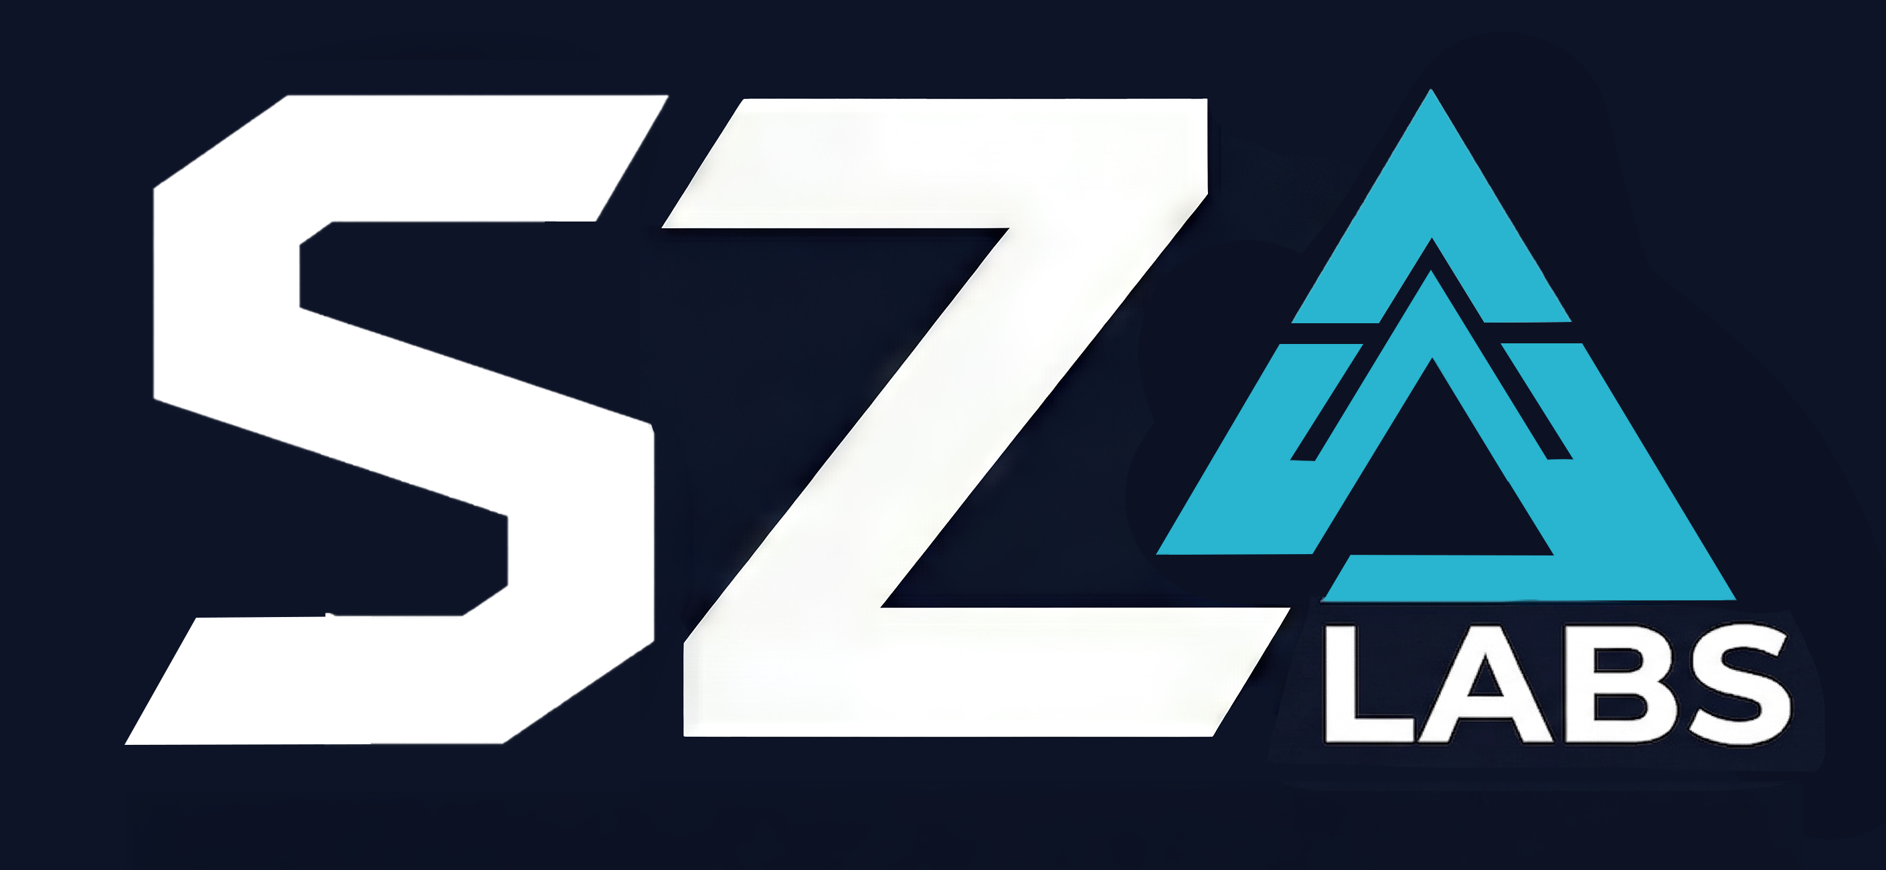
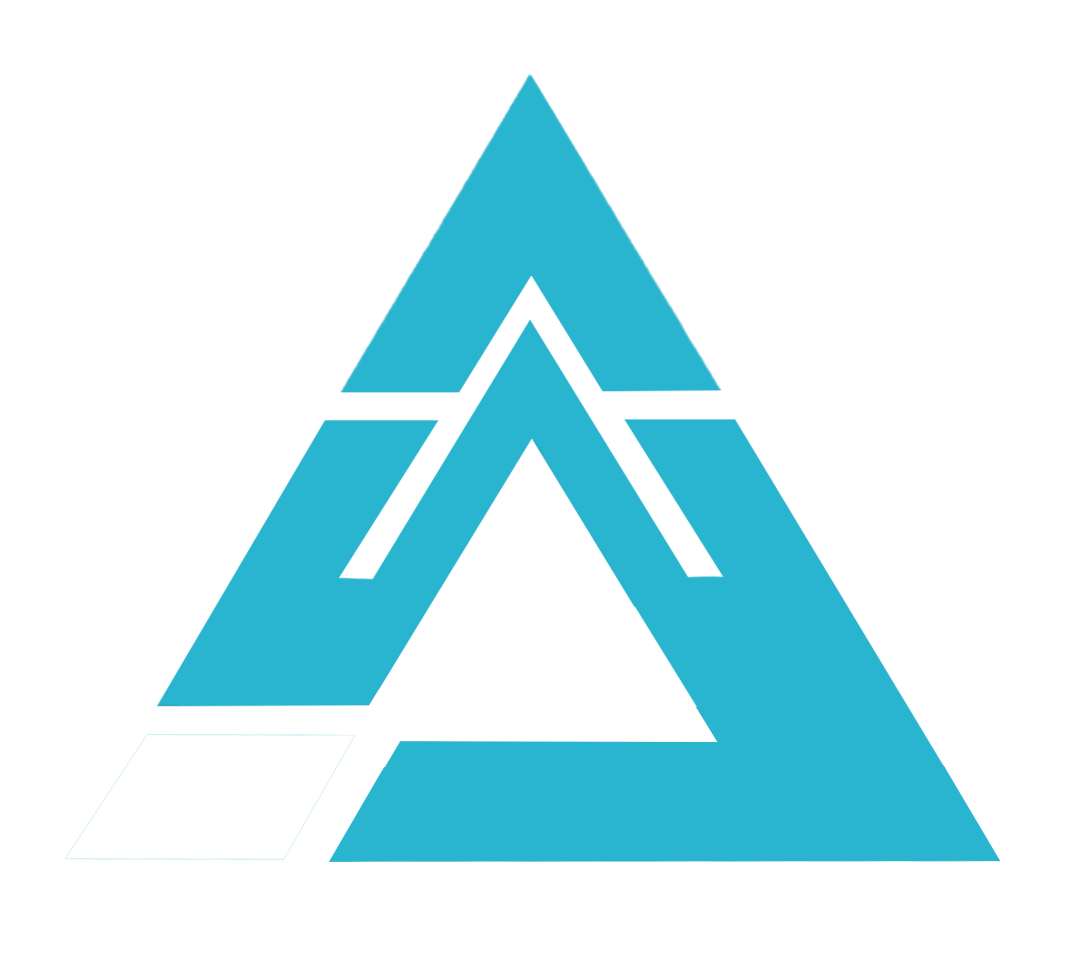
Tyler Sztuka
Founder, SZD Labs · Claude Community Ambassador · Atlanta
“Ensure AI enables and enhances human capability.”
Knowledge Base Development
Development and optimization for AI systems
Scalable Content Creation
Intelligent Content Creation and Distribution at scale
Claude Product Optimization
Helping orgs maximize Claude products internally
Open-Source Model Deployment
Own your tech stack and reduce API overhead

Slide 5

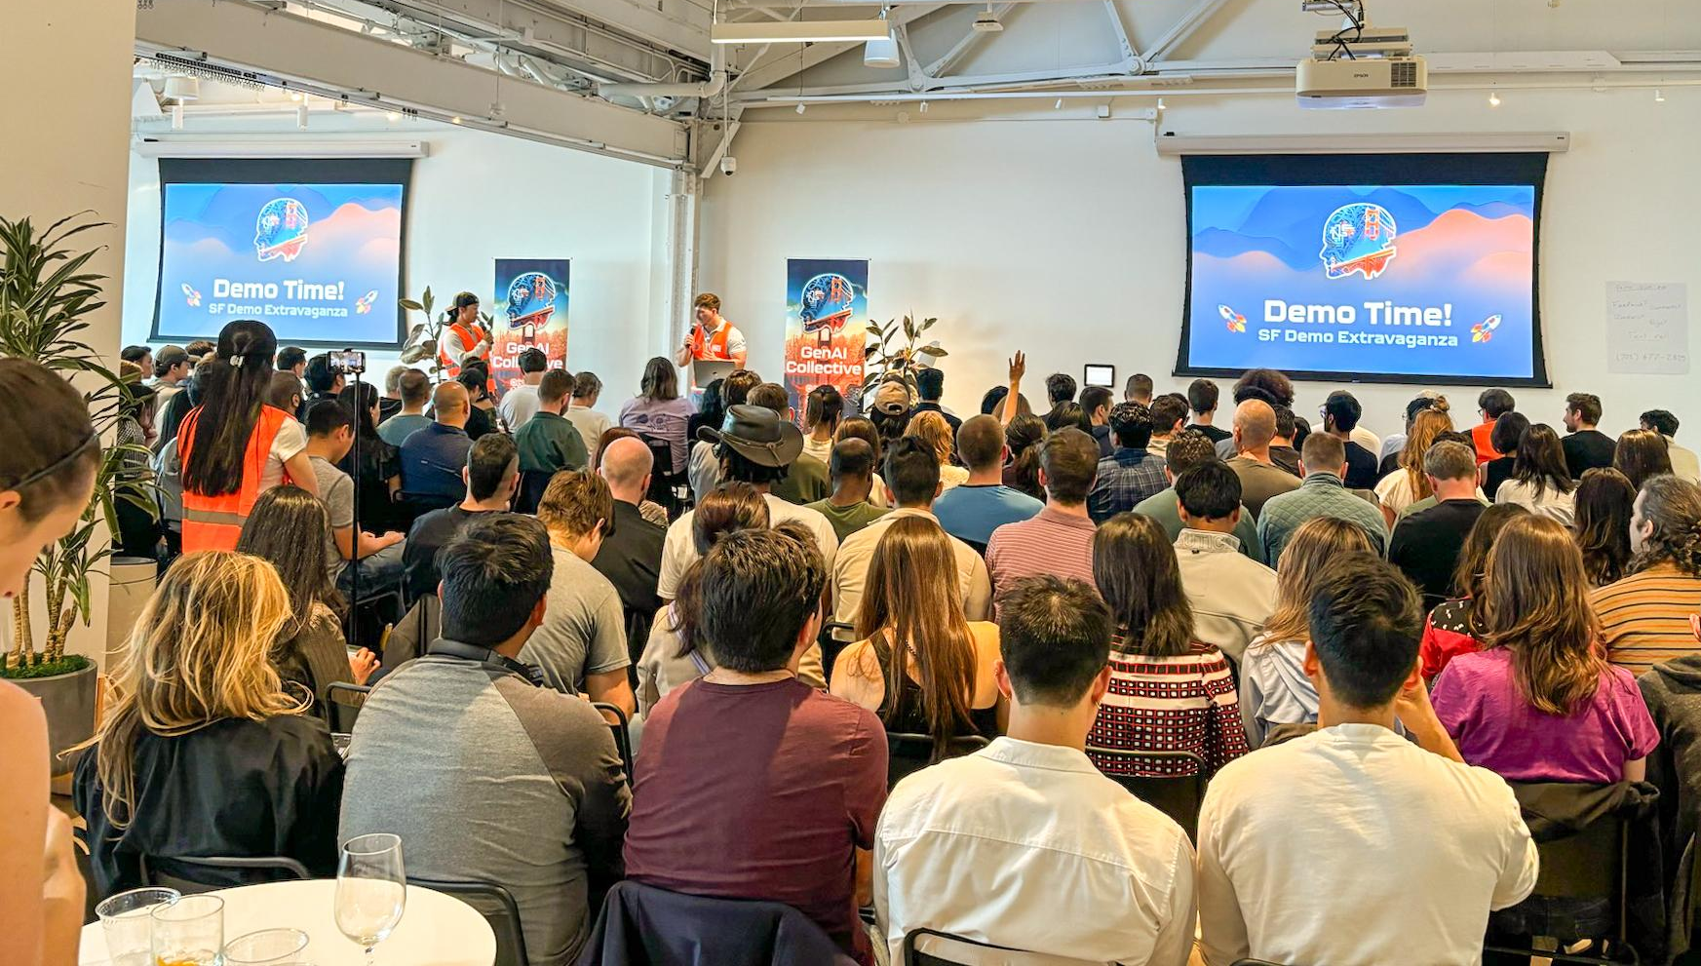
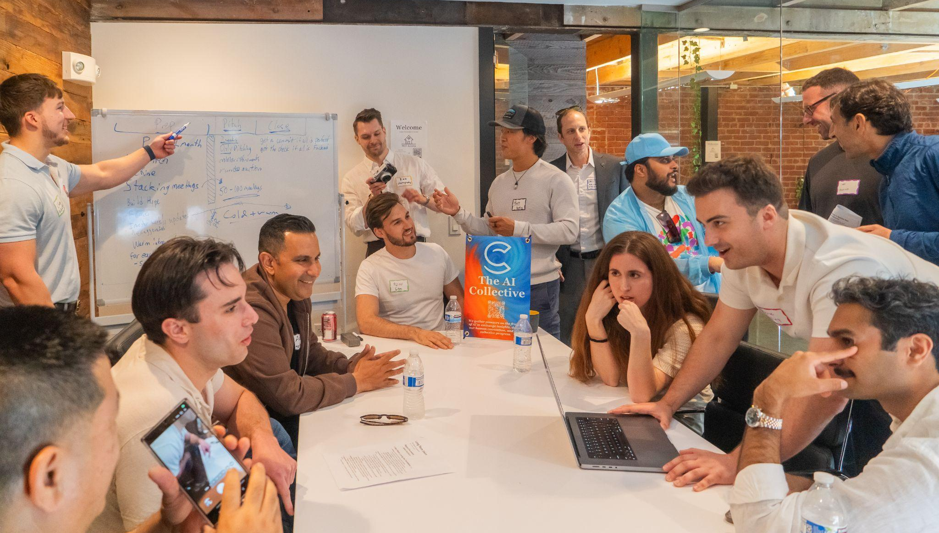
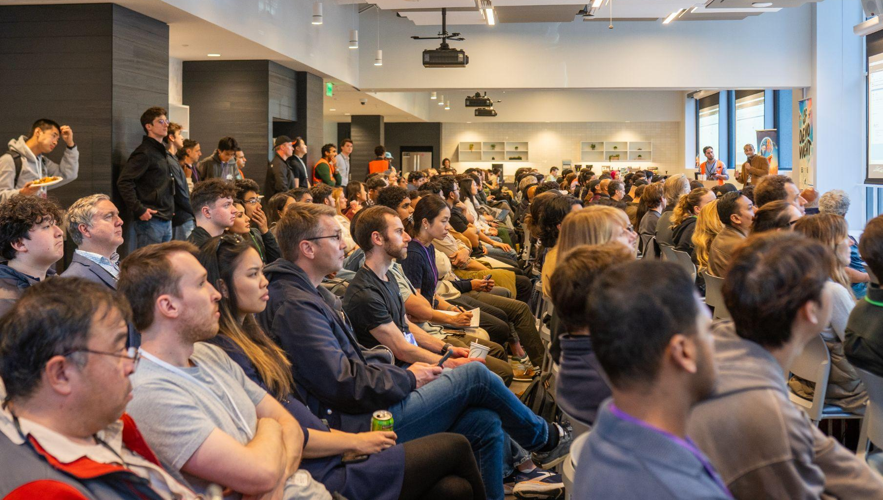
The AI Collective
We are a non-profit, grassroots community uniting 190k+ pioneers exploring the frontier of AI in major tech hubs worldwide.

Slide 6

What is The Claude
Community?
Get involved in the Claude Community to share solutions, help each other, and push the boundaries of what’s possible with AI.
-Local events hosted by Anthropic-appointed ambassadors
-Bringing together builders, practitioners, and curious minds across every industry.

Slide 7

What Is the Claude Community?
Share solutions. Help each other.
Push the boundaries of what's possible.
Anthropic's officially sponsored local events, managed by Claude Community Ambassadors
Why It Matters
Anthropic's core mission is building the models. Claude.ai, Claude Code, Cowork — those are prototypes. Beta products.
There is no golden playbook. We are all learning how to apply this technology in real time and that's exactly why this room matters.

Slide 8
This Is Just
the Beginning
Here’s what’s coming:
Claude Code Workshops
Deeper technical dives across industries and roles
Hackathons & Build-Outs
Time-boxed sessions where you ship something real
Live Technology Demos
See what’s actually possible with Claude right now
Industry-Specific Sessions
Claude for designers, AI for healthcare, and more
Direct Access to Anthropic
Employees, resources, and insider knowledge
Exclusive Swag & Gear
For community members
Learn from the People Building It
Straight from the source

Slide 9


Event Types
Claude Cowork
Claude Code Workshops
Hands-on sessions working with Claude on your actual projects. Setup, real workflows, real use cases.
Deeper technical dives — AI for developers, Claude Code for designers, industry-specific builds.
Hackathons
🏙️
Claude Impact Lab
Time-boxed build events. Ship something real by end of day. Teams or solo. Prizes + live demos.
Partnering with Atlanta nonprofits to solve real civic problems. Up to $5K Anthropic sponsorship.

Slide 10
Intro to
Claude Cowork

Slide 11
Context & Foundations
Part 1 — Where does Cowork sit in the AI ecosystem?
The Big Picture
Cowork is Claude Code’s capabilities in a visual interface — same underlying power, designed for people who don’t live in a terminal.
Why This Matters
Understanding the product stack helps you pick the right tool and set realistic expectations.

Slide 12
The Claude Product Stack
Three products, three mental models
Claude Chat
Claude Code
You ask, it answers. The conversational interface most people know. You’re always in the loop.
You assign, it executes. An agent harness with dynamic memory, goal-oriented loops, and sub-agents.
Claude Cowork
Key Distinction
You delegate, it delivers. Same agent architecture as Code, wrapped in a visual UI for non-terminal users.
Code and Cowork share the same engine. The difference is the interface and who it’s designed for.

Slide 13
The Birth of Cowork
Same power as Claude Code. Designed for the rest of us.
Why Cowork Exists
People were using Claude Code for non-dev tasks, but the terminal was a barrier. Cowork is the love child of Claude Code and the chat UI.
The Security Model
Cowork spins up a sandboxed Linux environment scoped to your folder. Can’t touch files outside unless you grant access to Chrome or connectors.
The Stateless VM
Dependencies installed during a session disappear when it ends. Safe sandbox for casual users; a limitation for technical users.
The Bottom Line
If the sandbox feels limiting, you want Claude Code. For everyone else, sandboxing is the feature, not the limitation.

Slide 14
The Three Models
Know your tools — Haiku, Sonnet, and Opus
Haiku — The Intern
Sonnet — The Employee
Fast and cheap. Simple tasks, reformatting, quick lookups. Use when speed matters more than depth.
Your daily driver. 90% of your work: writing, analysis, file processing, research. Start here.
Opus — The Consultant
$20/mo Plan Advice
Heavy hitter. Complex reasoning, multi-step planning, nuanced work. Powerful but expensive on usage.
Stick to Haiku and Sonnet. Opus eats your usage before you see the ROI.

Slide 15
Usage & Model Selection
Practical guidance for the $20/month plan
Usage Is Opaque
Fixed token allotment, but you don’t see raw costs in the UI. Cowork uses significantly more tokens than chat — it’s executing commands, not just generating text.
The Reality
On $20/mo, Cowork sessions are limited. One complex Opus task consumes what five Sonnet tasks would. Budget accordingly.
Tyler’s Rule of Thumb
Start on Sonnet, build the process, then try Haiku to save usage. Haiku is surprisingly good for most structured tasks.
Notes:
\.

Slide 16
The Eval Framework
How to systematically choose the right model
1. Start with the task
What are you trying to accomplish? Define it clearly.
2. Define known inputs
What data, files, or context goes in?
3. Establish expected output
What should come out, within some acceptable margin?
4. Build with top-tier first
Use Opus to prove the workflow works end-to-end.
5. Move down in cost
Switch to Sonnet, then Haiku — verify output quality stays within your threshold.

Slide 17
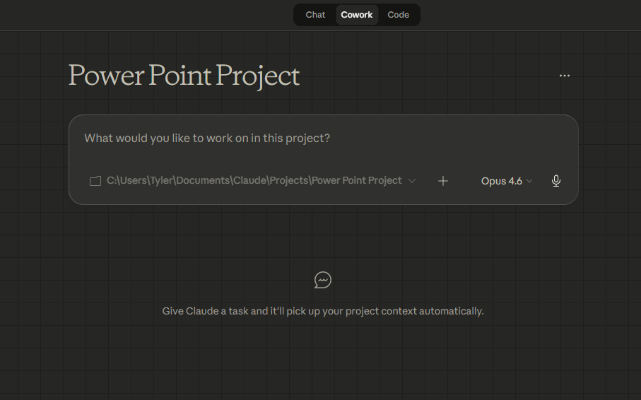
Getting Started with Cowork

Slide 18
Getting Started
Part 3 — Installation, interface, first steps
Pre-Check
Download
Laptop, Claude Desktop installed, $20/mo minimum subscription. Cowork is desktop-only — not the web browser.
Go to claude.ai/download. Install for Mac or Windows. Sign in with your Claude account.
The Interface
The Mental Shift
Mode selector (Chat/Cowork), task panel, file/folder access, model selector, connectors panel, and skills.
In chat you type and it responds. In Cowork you give it a workspace, point it at files, and delegate.

Slide 19
Using Cowork Safely
This is a research preview. You are an early user
of something still being built.
Before You Start
Stay Safe
• Requires Pro plan ($20/mo minimum)
• You’re giving Claude direct access to files, browser, and connected apps
• Think: hiring a smart intern and handing them your house keys
• Only grant access to specific folders
• Limit Chrome extension to trusted sites
• Read planned actions before approving
• Only connect MCPs you trust
Cowork activity is not captured in audit logs. Do not use for regulated workloads or compliance documentation.

Slide 20
Skills
Reusable instructions that teach Cowork how to do your work
What They Are
Training an employee: walk them through a task, correct them, get it right. A Skill writes down what you did so they can do it alone next time.
How to Build Them
Don’t start by building Skills. Do the work first. Then tell Cowork: turn what we just did into a Skill. It packages the instructions automatically.
Skills Become Plugins
Bundle related Skills into a Plugin. Example: a Marketing Plugin with /draft-linkedin, /repurpose-video, /seo-audit all in one package.

Slide 21
The Operationalization Arc
From chatbot to employee — the pattern that creates real value
1. Do the task manually
2. Convert to a Skill
Prove it works inside Cowork. Walk through it, correct the output, get it right.
Make it repeatable. One slash command triggers the whole workflow.
3. Schedule the Skill
4. Layer in context files
Make it autonomous. Set it to run daily, weekly, or on trigger.
Make it smarter over time. about_me.md, brand_voice.md, working_preferences.md compound.

Slide 22
Connectors
How Cowork reaches beyond your file system
What They Are
Pre-built integrations connecting Cowork to third-party apps. Click connect, authorize, and Cowork can read/write data from that service.
Available Now
Gmail, Calendar, Drive, Notion, Slack, Canva, GitHub, YouTube Studio, Microsoft 365, Fireflies, Apollo, Box, PayPal, Zapier — growing.
Permission Levels
Always Allow, Needs Approval (asks each time), or Block. Start with Needs Approval for everything. Promote once you trust the behavior.
Connectors Over Browser
If a connector exists, use it. Connectors are faster, more reliable, more secure, and use fewer tokens than browser automation.

Slide 23
Best Practices
Setup, usage, and safety — what separates good from great
Context Files Are Everything
Folder Structure Matters
Build about_me.md, brand_voice.md, working_preferences.md before anything else.
Dedicate specific folders per project. Tighter scope = better output.
Integration Priority
Review Before Execution
Connectors > desktop file access > Chrome extension > Computer Use. Each step down costs more tokens.
Cowork shows what it’s going to do. 30 seconds reviewing prevents minutes of drift.
Safety First
Keep Context Tight
Never let Cowork send without approval. Folder-level access, not drive-wide.
New tasks for new topics. Don’t let conversations sprawl.

Slide 24
Live Demos
Part 5 — Real workflows, built in real time
Demo 1: Project Setup & Interface
Creating a project, writing instructions, connecting services, and showing what Cowork sees when it starts a task.
Demo 2: Transcript Processing Pipeline
Tyler’s production workflow. Raw transcript in, structured intelligence out — entities, action items, knowledge extraction.
Demo 3: Personal Data Contextualization
Extract everything AI learned about you from chat history. Build a profile that makes every future conversation start informed.

Slide 25
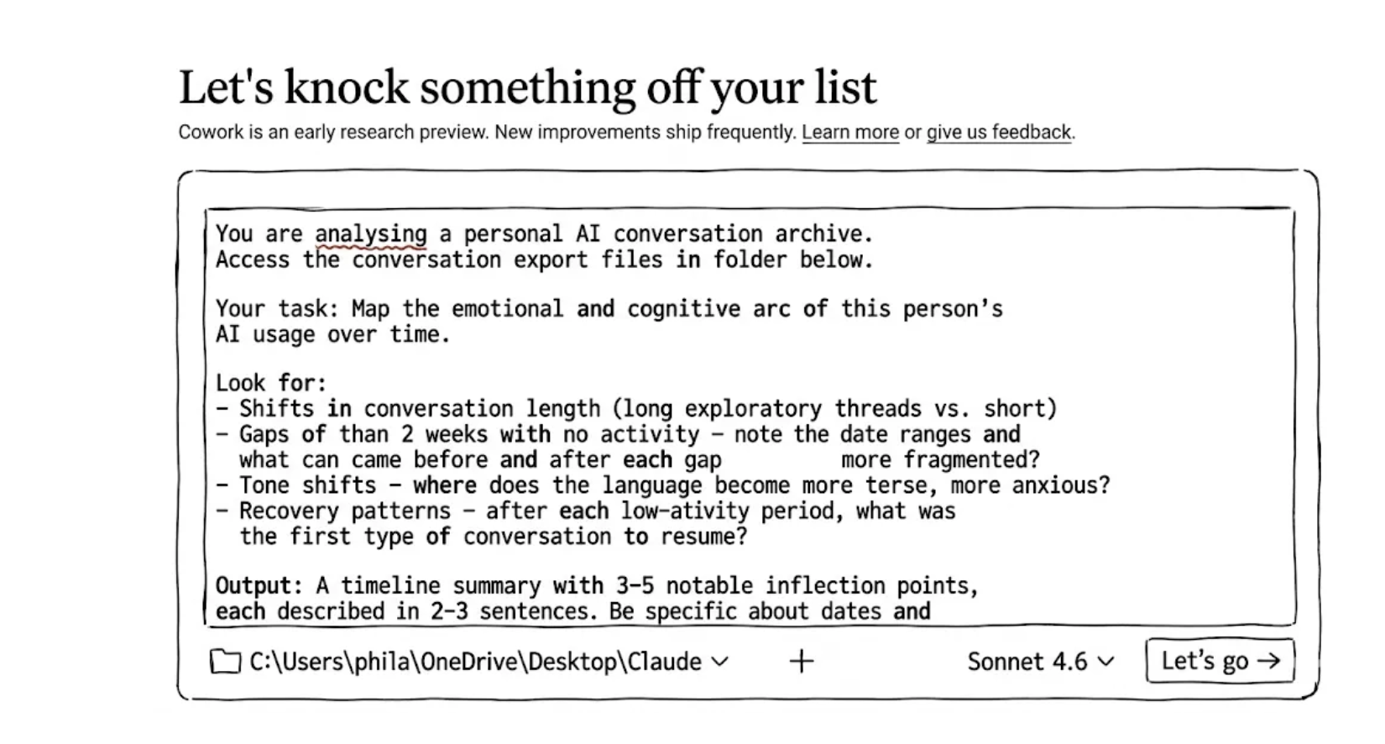
Live Demos
Part 5 — Real workflows, built in real time
https://phillipalcock.substack.com/p/your-ai-chat-history-is-a-dataset

Slide 26
Demo Highlights
What to watch for during live demos
The Setup Payoff
Notice how project setup, context files, and connectors compound. A well-configured project makes every task dramatically better.
The Transcript Pipeline
45-60 minutes manually, ~3 minutes in Cowork. Not just summarizing — extracting structured data and comparing against existing knowledge.
The Operationalization Arc in Action
Each demo: build it once, prove it works, capture as a reusable workflow. That’s how a chatbot becomes infrastructure.

Slide 27
Key Takeaways
What to remember from today
The Arc
Setup Is the Differentiator
Do the task → Convert to Skill → Schedule it → Layer context. That’s how a chatbot becomes an employee.
The question isn’t whether AI can do your work. It’s whether you’ve built the infrastructure for it to do your work well.
Start Small, Compound
Custom MCP Servers
One project, one context file, one connector, one real task. Then turn it into a Skill. Then schedule it.
Want to go deeper? Build custom connectors for your tools. Talk to Tyler about tech stack and deployment.

Slide 28
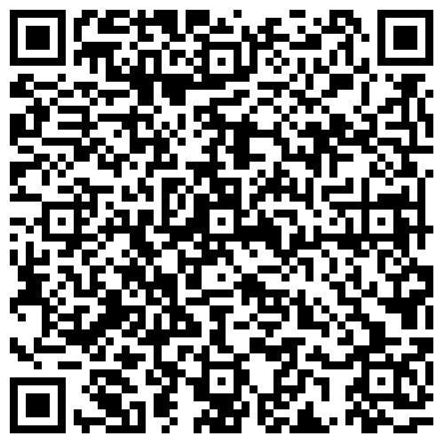
What's Next
REGISTER NOW
April 27 — GSU –Student hackathon
[ QR Code
April 8 ]
TBD…..

Slide 29
Let's Build
Something.
Open Networking
Co-hosting or sponsoring?.
Event ideas? I want to hear them.
Want to help drive this community?
Claude questions?

